Slide 1
Topic: Systematic approach to factor Investing in Stock Market
REVA Academy for Corporate Excellence (RACE)
Date:21/5/2021
Name of the Presenter(s)
Anand Mohan
Batch:MBA06
Trimester: THIRD TRIMESTER
SRN: R19MBA53
www.race.reva.edu.in

Slide 2
Background Information
As with any investment, there's no guarantee of performance.
Individual factors have tended to perform well at different parts of the economic cycle, and may be less correlated with equity market moves.
A multi-factor investment is diversified across factors and may help to reduce the effect of this cyclicality.
Now, we will go through the different types of risks an investor may have to face so as to get a more clearer picture of the job at hand and to gain better understanding on what lies ahead as corrective measures to be taken accordingly.

Slide 3
Background Information
What are the main categories of risk we should be concerned about when making any financial investment?
Systematic & Unsystematic risk
Inflation risk
Sentiment risk
Interest Rate risk
Credit risk
Currency risk
Liquidity risk
Event risk
Political risk
Operational risk
Relative risk
Gearing risk
Non-diversification risk

Slide 4
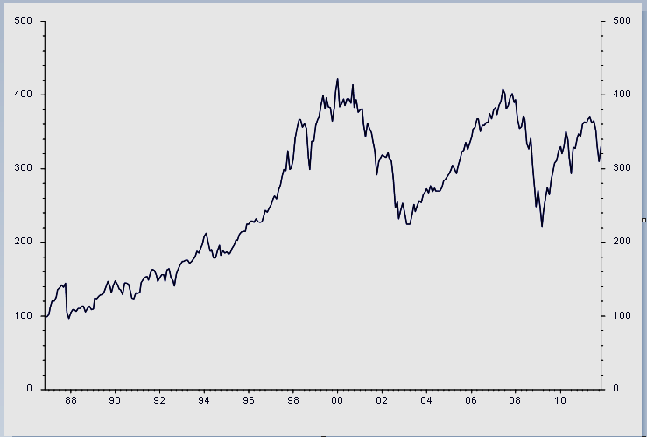
Background Information
Long term performance OK but….

Slide 5
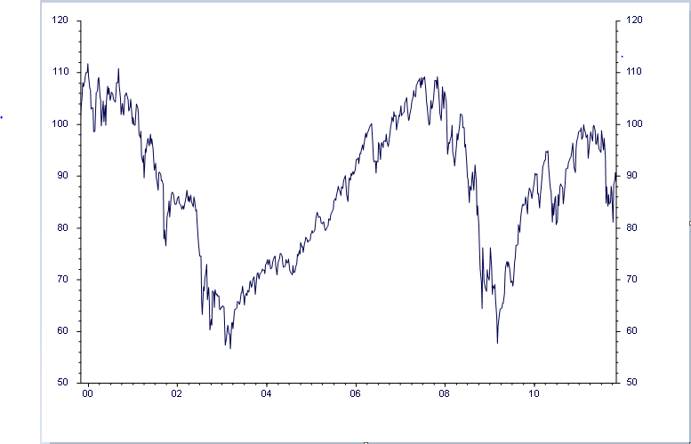
Background Information
How long is long term?

Slide 6
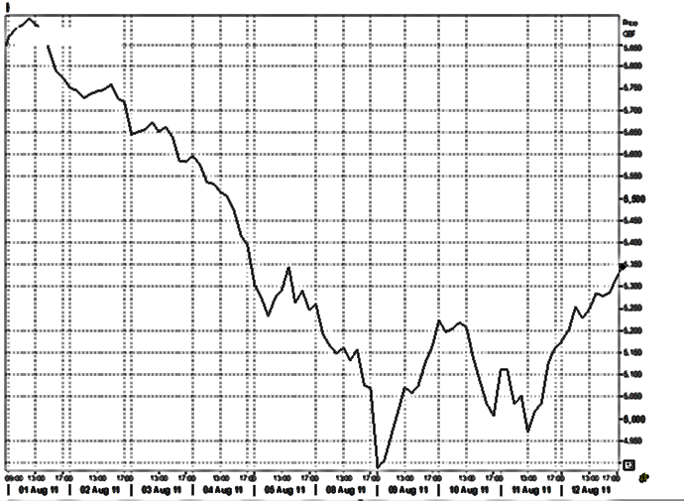
Background Information
Example of short term volatility

Slide 7
Background Information
Systematic and Unsystematic Risk
Systematic Risk – also known as Market Risks are those risks which
affect all companies within a market in one way or another.
For example:
Inflation
Recession
Interest Rates
Political Instability
Exchange Rates
War
Confidence
Unsystematic Risk – also known as Specific Risk are risks which are unique to the company.
Strength of Management ( Marks & Spencer)
Range of Products (Unilever)
Geographic Location (McDonald’s)
Financial Position (BP Finance Inc)
Innovational Factor (Apple)
Total Risk = Unsystematic Risk + Systematic Risk

Slide 8
Background Information
Beta:
One of key concepts of investment management and portfolio management is diversification.
You can diversify some of the portfolio risk away by investing in investments with different levels of risk measured by a company’s Beta.
Beta is the measure of the average historic volatility of a security’s return to the broader market risk and is stated as a proportion of the market risk.
Beta for the whole market is deemed to be 1. A stock with a Beta of 1 is likely to move with the market. One with a Beta of 2 will move by twice the market – in both directions.
Beta < 1 – Stock described as defensive ( probably income producer)
Beta > 1 – Stock aggressive & cyclical ( probably growth stock)
Beta can also be negative i.e. if market rises, investment likely to fall and vice-versa.

Slide 9
Background Information
Modern Portfolio Theory-Alpha and Beta
Modern Portfolio theory developed by Harry Markowitz in 1952 indicates that much of the unsystematic risk can be factored out by spreading funds over more investments.
How many is deemed to be the minimum?
15-20
Modern Portfolio theory states that 95% of the unsystematic risk can be eliminated with 20 securities
Alpha:
Alpha is the risk adjusted measure of the active return on an investment.
It is basically a measure of a fund manager’s stock-picking skill, with Alpha being used to measure individual securities, portfolios or funds.
A positive Alpha is good news and the higher the better.
Alpha= Annual Return - Expected Return
Expected Return = Average Annual Risk Free Return + Beta
(Annual Market Return-Risk Free Return)

Slide 10
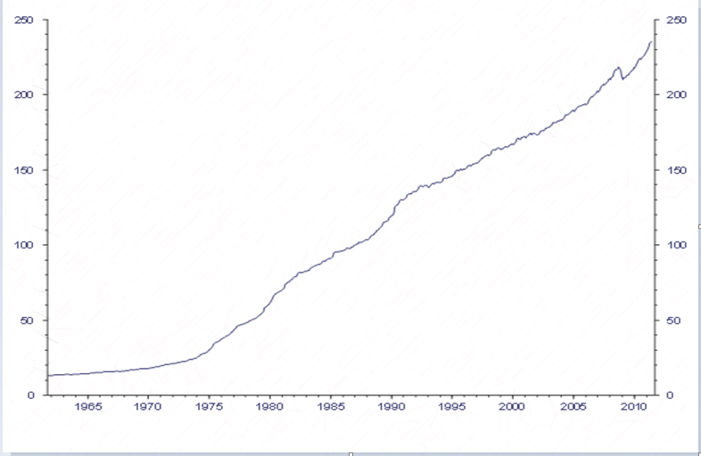
Background Information
Inflation Risk:
Inflation is a real risk for every company. Why?
Difficulty controlling costs.
Budgeting
Goods/services can become uncompetitive.
Wage demands escalate as rise in cost of living is highlighted.
Historically, which investments have benefited most from inflation?
Shares,Property,Index-linked investments (government stock).However, liquidity requirements may knock the ‘real’ assets theory off course as there needs to be a buyer for a seller to realize his/her profit.

Slide 11
Background Information
Income & Capital Growth, Sentiment – Risk of shortfall:
Capital: There is always a risk that an investor’s capital falls in value rather than grows, thus creating a shortfall – in real terms or in investor’s expectations –Know Your Client especially important in these circumstances.
Income: Income may be cut through a company defaulting on its fixed interest payments or cutting its dividend through a drop in profitability. It may also not raise its dividend by sufficient each year to combat inflation.
The more certainty of income is required, the lower the level of income likely to be available or the more in-depth research will be require.
Sentiment:Not a factor to be ignored but impossible to quantify.Investors who believed gold, commodities, property, technology shares, antiques, fine art or even tulip bulbs could only go in one direction have been responsible for many crashes over the centuries.

Slide 12
Background Information
Interest Rate , Credit , Currency, Liquidity & Access Risks :
Interest Rate Risk: Key factors in interest rate moves are The Economic Cycle, Government Fiscal Policy, Inflation Expectations and Preference for liquid investments
Credit Risk: Three types of credit risk may be categorized as Risk of default, Downgrade risk, Credit spread risk.
Currency Risk: When investments made in overseas quoted investments by an investor, there is the risk that the currency will move adversely.
Liquidity & Access Risk: Particularly relates to smaller companies or unit trusts with assets that are not easy to trade. Market makers protect themselves by reducing the number of shares they will trade to the minimum stipulated by the Stock Exchange in that particular company. Might be 1000 shares at 25p each!.
Asset classes such as commercial property companies and private equity (for example 3i) can also be vulnerable. On a wider basis, residential property can go from being reasonably liquid to illiquid in a very short space of time. Thus access to liquidity can prove difficult.

Slide 13
Background Information
Event , Political , Currency, Liquidity & Access Risks :
Event Risk Examples:9/11,Earthquake in Japan,Industrial Accident. Some companies are unable to pay their full dividend due to an unexpected event causing downfall but it could happen as a result of a natural disaster, a corporate change or a regulatory changes in their polies and formulations.
Political Risk: Change of government creating new fiscal and monetary policies, Quantitative Easing, Change in taxation system,Nationalisation or confiscation of assets, Corruption.
Operational Risk (including fraud & counterparty risk):These are risks that lead to a fall in value resulting in an investor not meeting his/her risk and return objectives. Operational risk looks at risks that arise from the investment process. These include:
Counterparty/Settlement Risk - the counterparty (often institutional), to a transaction may fail to settle
Fraud – internal or external – misappropriation of funds – Keydata - Madoff
Misrepresentation – misleading reports & valuations (tend to come to light in a recession)
System Failure
Trading within institutions – trading errors and unauthorized trading
Staff errors
Regulatory (fines,Sanctions,Delisting)

Slide 14
Background Information
Gearing Risks & The risk of Leverage:
Type of risk which involves either borrowing funds to increase the amount
available for investment or buying an investment such as an investment
trust warrant which will react by a greater percentage than the underlying
investment. Options, CFDs and other derivatives have the same geared
risk elements.
Investor has £2500 to invest
Sure investment is going to rise so borrows £2500 and invests £5000
Shares rise 50% so sell for £7500 and repays loan
Percentage profit 100% less loan costs.
However, if shares fall 50% investment wiped out plus costs of loan.

Slide 15
Background Information
Key points on risks Mitigation:
Market Timing: Timing and timescales are very important but very hard to predict short term movements. Luck is a factor whether you like to admit it or not. Essential to ensure the client understands that, if a long term investor rather than a short term trader, they need to be able to ‘ride out’ any volatility if investing in these markets.
Systematic Risk is market risk whereas unsystematic risk refers to specific risk, or investment specific risk.
Inflation is a major risk for investors particularly those invested in cash deposits or fixed interest securities which are not index- linked. Real assets such as property and equities can provide some inflation protection.
Interest Rate risk is measured by duration, fixed interest securities will lose value when rates rise and vice versa. Fixed interest investments are also subject to credit risk.
Investors buying outside their base currency are taking on currency risk.
Other main risks are political, event, liquidity and operational risk also need to be taken care.

Slide 16
Background Information
Key points on risks Mitigation:Diversification
Diversification refers to combining risky investments in a way that reduces the overall risk of a portfolio.
Diversification can be carried out at the asset class or geographical level or by holding a diversified portfolio of securities within a single market.
Diversification can come in various forms:
Different Asset classes can be held in portfolio – different betas to smooth out returns.
Equity investment spread over world markets. Individual stock markets do not always move in the same direction although correlation has increased in recent years.
Use collective investments rather than individual companies.
Spread equity investment across the market to avoid reliance on any one sector (i.e., Banks).

Slide 17
Statement of the Problem
Maximizing Returns:
As an investor you want to maximize the returns for a given level of risk. The relationship between the returns for the different assets in the portfolio is important. A good portfolio is not simply a collection of individually good investments.
Risk Aversion:
Given a choice between two assets with equal rates of return, most investors will select the asset with the lower level of risk. Risk aversion is a consequence of decreasing marginal utility of consumption.
In a nutshell we can conclude that modern investors want maximum returns and minimal risks. Having defined the problem statement we will explore various possibilities starting with Markowitz Portfolio Theory and then moving on to CAPM and then to arbitrage-pricing-theory and then finally arrive at multi factor investments as the most latest paradigm applied in stock market portfolios formulations.

Slide 18
Statement of the Problem
Assumptions of Markowitz Portfolio Theory:
Investors consider each investment alternative as being presented by a probability distribution of expected returns over some holding period.
2. Investors minimize one-period expected utility, and their utility curves demonstrate diminishing marginal utility of wealth.I.e., investors like higher returns, but they are risk-averse in seeking those returns And, again, this is a one-period model (i.e., the portfolio will need to be rebalanced at some point in the future in order to remain optimal).
3. Investors estimate the risk of the portfolio on the basis of the variability of expected returns. I.e., out of all the possible measures, variance is the key measure of risk

Slide 19
Statement of the Problem
Assumptions of Markowitz Portfolio Theory:
4. Investors base decisions solely on expected return and risk, so their utility curves are a function of only expected portfolio returns and the expected variance (or standard deviation) of portfolio returns.
Investors’ utility curves are functions of only expected return and the variance (or standard deviation) of returns. Stocks’ returns are normally distributed or follow some other distribution that is fully described by mean and variance.
5. For a given risk level, investors prefer higher returns to lower returns. Similarly, for a given level of expected returns, investors prefer less risk to more risk.
Using these five assumptions, a single asset or portfolio of assets is considered to be efficient if no other asset or portfolio of assets offers higher expected return with the same (or lower) risk, or lower risk with the same (or higher) expected return.

Slide 20
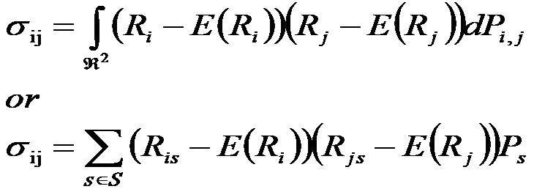
Statement of the Problem
Portfolio Standard Deviation Calculation:
Any asset of a portfolio may be described by two characteristics:
The expected rate of return
The expected standard deviations of returns.
Third characteristic, the covariance between a pair of stocks, also drives portfolio standard deviation.
Covariance of Returns:
Covariance is a measure of the degree of “co-movement” between two stocks’ returns, or the extent to which the two variables “move together” relative to their individual mean values over time.
For two assets, i and j, the covariance of rates of return is defined as:

Slide 21
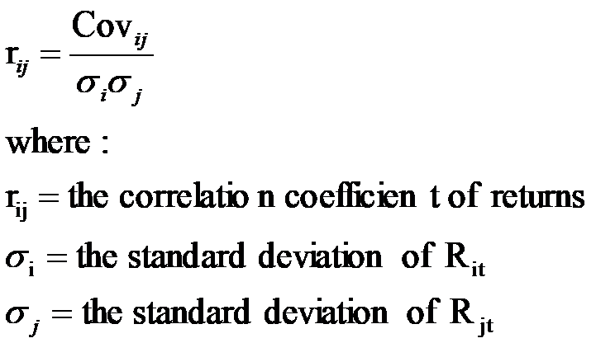
Statement of the Problem
Covariance and Correlation:
The correlation coefficient is obtained by standardizing (dividing) the covariance by the product of the individual standard deviations.
Correlation Coefficient:
It can vary only in the range +1 to -1. A value of +1 would indicate perfect positive correlation. This means that returns for the two assets move together in a completely linear manner. A value of –1 would indicate perfect correlation. This means that the returns for two assets have the same percentage movement, but in opposite directions.

Slide 22

Statement of the Problem
Portfolio Returns and Portfolio Risk:
By investing in many different stocks to form a portfolio, we can lower the risk without lowering the expected return. To calculate a portfolio’s expected rate of return, we weight each individual investment’s expected rate of return using the fraction of money invested in each investment.
Evaluating Portfolio Risk:
Unlike expected return, standard deviation is not generally equal to the a weighted average of the standard deviations of the returns of investments held in the portfolio. This is because of diversification effects.
The diversification gains achieved by adding more investments will depend on the degree of correlation among the investments.
The degree of correlation is measured by using the correlation coefficient

Slide 23
Statement of the Problem
Correlation and diversification:
The correlation coefficient can range from -1.0 (perfect negative correlation), meaning two variables move in perfectly opposite directions to +1.0 (perfect positive correlation), which means the two assets move exactly together.
A correlation coefficient of 0 means that there is no relationship between the returns earned by the two assets.
As long as the investment returns are not perfectly positively correlated, there will be diversification benefits.
However, the diversification benefits will be greater when the correlations are low or negative.
The returns on most stocks tend to be positively correlated.

Slide 24

Statement of the Problem
Diversification effect:
Investigate the equation:
When the correlation coefficient =1, the portfolio standard deviation becomes a simple weighted average:
If the stocks are perfectly moving together, they are essentially the same stock. There is no diversification.
For most two different stocks, correlation is less than perfect (<1). Hence, the portfolio standard deviation is less than the weighted average. – This is the effect of diversification.

Slide 25
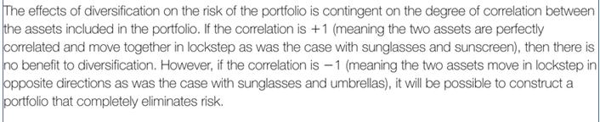
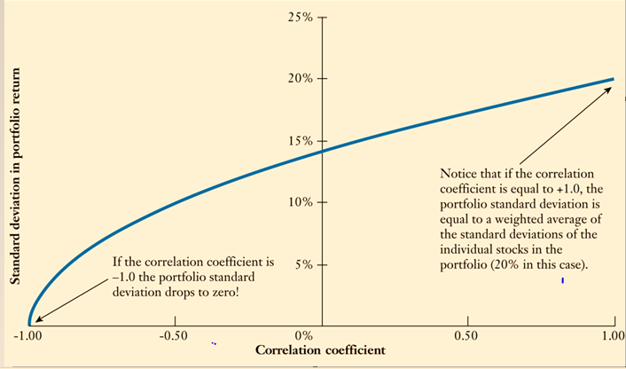
Statement of the Problem
Diversification effect:

Slide 26
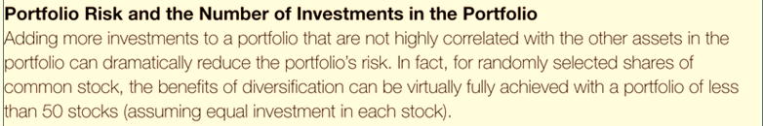
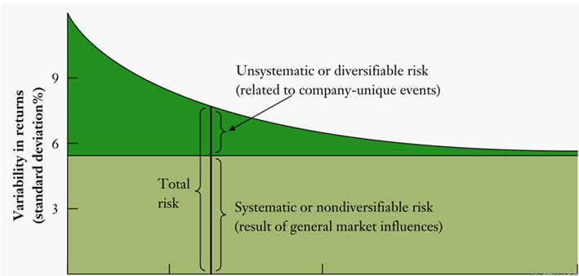
Statement of the Problem

Slide 27
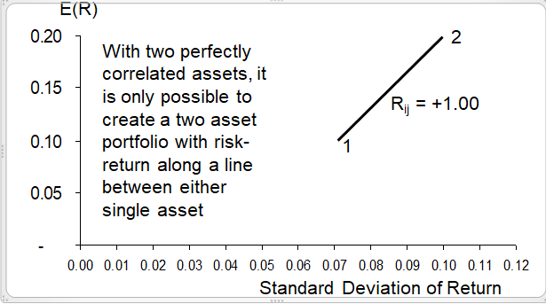
Statement of the Problem
Portfolio Risk-Return Plots for Different Weights

Slide 28
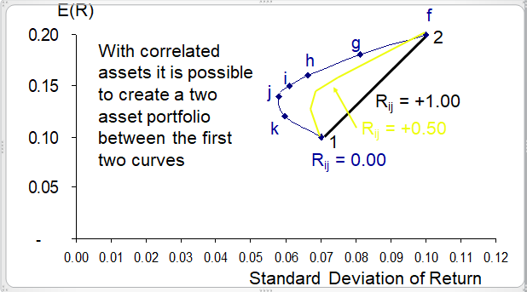
Statement of the Problem
Portfolio Risk-Return Plots for Different Weights

Slide 29
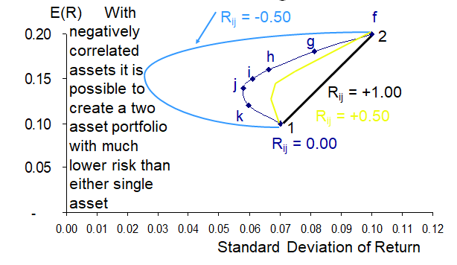
Statement of the Problem
Portfolio Risk-Return Plots for Different Weights

Slide 30
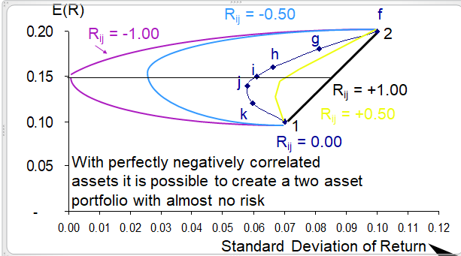
Statement of the Problem
Portfolio Risk-Return Plots for Different Weights

Slide 31
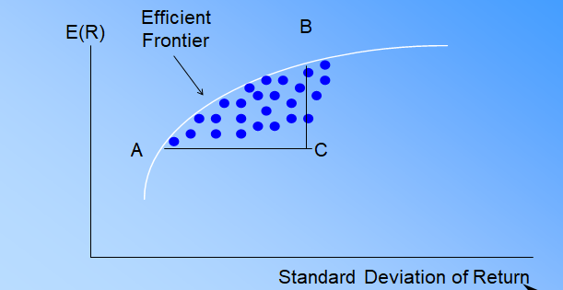
Statement of the Problem
The Efficient Frontier
The efficient frontier represents that set of portfolios with the maximum rate of return for every given level of risk, or the minimum risk for every level of return.
Frontier will be portfolios of investments rather than individual securities
Exceptions being the asset with the highest return and the asset with the lowest risk.

Slide 32
Statement of the Problem
The Efficient Frontier and Investor Utility
An individual investor’s utility curve specifies the trade-offs he is willing to make between expected return and risk.
The slope of the efficient frontier curve decreases steadily as you move upward
These two interactions will determine the particular portfolio selected by an individual investor.
The optimal portfolio has the highest utility for a given investor
It lies at the point of tangency between the efficient frontier and the utility curve with the highest possible utility.

Slide 33
Statement of the Problem
Systematic versus Idiosyncratic Risk:
An investment’s systematic risk is far more important than its unsystematic risk.
If the risk of an investment comes mainly from unsystematic risk, the investment will tend to have a low correlation with the returns of most of the other stocks in the portfolio, and will make a minor contribution to the portfolio’s overall risk.
Diversification and Systematic Risk:
Systematic or non-diversifiable risk is not reduced even as we increase the number of stocks in the portfolio.
Systematic sources of risk (such as inflation, war, interest rates) are common to most investments resulting in a perfect positive correlation and no diversification benefit.
Large portfolios will not be affected by unsystematic risk but will be influenced by systematic risk factors.

Slide 34
Statement of the Problem
Limitations of Markowitz portfolio optimization:
1.Too many inputs required
It Limit use to asset allocation or small-scale problems
2.Use of estimates can lead to “error maximization”
It Introduce additional “hard” constraints in optimization process.we need to Use “portfolio resampling” to find average optimal portfolio given range of possible estimates.
3.Reliance on historical data to obtain estimates
True parameters not only never known, but also not constant over time.

Slide 35

Statement of the Problem
Systematic Risk and Beta:
Systematic risk is measured by beta coefficient, which estimates the extent to which a particular investment’s returns vary with the returns on the market portfolio.
The CAPM:
CAPM also describes how the betas relate to the expected rates of return that investors require on their investments.
The key insight of CAPM is that investors will require a higher rate of return on investments with higher betas. The relation is given by the following linear equation:
R_{market} is the expected return on the market portfolio
R_{f} is the risk free rate (return for zero-beta assets).

Slide 36
Statement of the Problem
Arbitrage pricing theory :
Arbitrage pricing theory (APT) is a valuation model. Compared to CAPM, it uses fewer assumptions but is harder to use. The basis of arbitrage pricing theory is the idea that the price of a security is driven by a number of factors. These can be divided into two groups: macro factors and company specific factors.
APT theory predicts a relationship between the returns of a portfolio and the returns of a single asset through a linear combination of many independent macro-economic variables.
The general idea behind APT is that two things can explain the expected return on a financial asset:
1) macroeconomic/security-specific influences
2) the asset's sensitivity to those influences. This relationship takes the form of the linear regression formula.
There are an infinite number of security-specific influences for any given security including inflation, production measures, investor confidence, exchange rates, market indices or changes in interest rates. It is up to the analyst to decide which influences are relevant to the asset being analyzed.

Slide 37
Statement of the Problem
Difference between CAPM and Arbitrage Pricing Theory::
The Arbitrage Pricing Theory and the Capital Asset Pricing Model (CAPM) are the two most influential theories on stock and asset pricing today.
The difference between CAPM and arbitrage pricing theory is that CAPM has a single non-company factor and a single beta, whereas arbitrage pricing theory separates out non-company factors into as many as proves necessary.
Arbitrage pricing theory does not rely on measuring the performance of the market. Instead, APT directly relates the price of the security to the fundamental factors driving it.
Each of these requires a separate beta. The beta of each factor is the sensitivity of the price of the security to that factor.
Intuitively, the APT makes a lot of sense because it removes the CAPM restrictions, and basically states "The expected return on an asset is a function of many factors as well as the sensitivity of the stock to these factors." As these factors move, so does the expected return on the stock, and therefore its value to the investor.

Slide 38
Statement of the Problem
Difference between CAPM and Arbitrage Pricing Theory::
In the CAPM theory, the expected return on a stock can be described by the movement of that stock relative to the rest of the market. The CAPM is really just a simplified version of the APT, whereby the only factor considered is the risk of a particular stock relative to the rest of the market, as described by the stock's beta.
The problem with this is that the theory in itself provides no indication of what these factors are, so they need to be empirically determined. Obvious factors include economic growth and interest rates. For companies in some sectors other factors are obviously relevant as well - such as consumer spending for retailers.
The potentially large number of factors means more betas to be calculated. There is also no guarantee that all the relevant factors have been identified. This added complexity is the reason arbitrage pricing theory is far less widely used than CAPM.

Slide 39
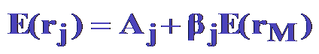
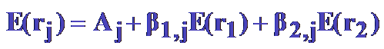

Statement of the Problem
Models for Estimating Expected Return:
One Factor Systematic Risk Model:
Two Factor Systematic Risk Model:
N Factor Systematic Risk Model:
We may observe that Numerous Other Factors May Be Used in Predicting Expected Return. A review however, will reveal that this subject is indeed controversial. In essence, we can spend the rest of our lives trying to determine the “best factors” to use.

Slide 40
Statement of the Problem
Fama and French Literature on Factor Models:
It is once again An alternative asset pricing model to CAPM.
Three risk factors affecting asset expected return (Fama and French, 1993):
Market risk premium
Size effect or size premium
Book-to-Market value effect or value premium

Slide 41
Statement of the Problem
Other Factors That May Be Used in Predicting Expected Return::
Technical Analysis:
Analyze past patterns of market data (e.g., price changes) in order to predict future patterns of market data. “Volumes have been written on this subject.
Size Effect:
Returns on small stocks (small market value) tend to be superior to returns on large stocks. Note: Small NYSE stocks tend to outperform small NASDAQ stocks.
January Effect:
Abnormally high returns tend to be earned (especially on small stocks) during the month of January.
And the List Goes On......

Slide 42
Statement of the Problem
Other Factors That May Be Used in Predicting Expected Return::
Liquidity (e.g., bid-asked spread):
Negatively related to return [e.g., Low liquidity stocks (high bid-asked spreads) should provide higher returns to compensate investors for the additional risk involved.]
Value Stock Versus Growth Stock:
P/E Ratios:
Low P/E stocks (value stocks) tend to outperform high P/E stocks (growth stocks).
Price/(Book Value):
Low Price/(Book Value) stocks (value stocks) tend to outperform high Price/(Book Value) stocks (growth stocks).

Slide 43
Proposed Solution
A new approach has recently emerged in investment practice known as Multi factor investing, which recommends that allocation decisions be expressed in terms of risk factors, as opposed to standard asset class decompositions.
Factors have historically been identified as critical drivers of portfolio risk and return and can now be used to better inform the investment process.
Factors may help investors meet their objectives such as reducing risk, increasing returns, and increasing diversification by providing a better understanding of risk and returns.

Slide 44
Proposed Solution
We will apply fewer Modeling Approaches to arrive at some Actionable Insights for profit which may be following:
1.principal component analysis:
We will find subset of variables that are the essential ones within the higher set of variables, and there's a method in statistics called principal component analysis. It is a method that allows to take a high dimensional set of data, projected on to much lower dimensions and give us basic information about what's important and what's not important.
2.cluster analysis:
A second approach that we're going to use is what's called cluster analysis. We will find clusters that somehow have commonality that are relatively homogeneous among themselves. And we will separate the data into clusters where there's one group of companies that act very similarly, from another group that that acts in a different way.

Slide 45
Proposed Solution
We are going to combine the PCA and the clustering to give us information that we can use in our investment strategies.
3.Graphical analysis:
•Here we take a group of companies and we put them in a network where the connections are indicated through the arcs in the network, the lines that connect the points. And the location on the network tells us, how central that company is, relative to everyone else. So the graphical analysis tells us what's the relationship among companies and how central are they in terms of their influences on other companies and we're going to use this over time to identify patterns that we might find. The courses will change, we will see this graph moving across time, and that will give us additional information.
•We need to find ways to identify patterns in the data. And we want to do that through these three methods, the principal component analysis, the clustering, and the graphical analysis.

Slide 46
Proposed Solution
There are two main types of factors that have driven returns: macroeconomic factors, which capture broad risks across asset classes; and style factors, which help to explain returns and risk within asset classes.
Macroeconomic factors:
1. Economic growth: Exposure to the business cycle
2. Real rates: The risk of interest-rate movements
3. Inflation: Exposure to changes in prices
4. Credit: Default risk from lending to companies
5. Emerging markets: Political and sovereign risks
6. Liquidity: Holding illiquid assets

Slide 47
Proposed Solution
Style factors:
1. Value: Relatively inexpensive stocks. Captures excess returns to stocks that have low prices relative to their fundamental value
2. Low size (small cap): smaller companies. Captures excess returns of smaller firms (by market capitalization) relative to their larger counterparts
3. Momentum: rising stocks. Reflects excess returns to stocks with stronger past performance
4. Low volatility: lower risk stocks. Captures excess returns to stocks with lower than average volatility, beta, and/or idiosyncratic risk.

Slide 48
Proposed Solution
Style factors:
5. Dividend yield: cash flow paid out. Captures excess returns to stocks that have higher-than-average dividend yields
6. Quality: sound balance sheet stocks. Captures excess returns to stocks that are characterized by low debt, stable earnings growth, and other “quality” metrics
7. Growth: Measure of change in sales and earnings. Measures company growth prospects using historical earnings, sales and predicted earnings
8. Liquidity: Size-adjusted trading volume. Captures common variations in stock trading volumes relative to available shares trading.
The objective is to survey, study, and examine various facets and provide better solutions to overcome the challenges in Factor investing.
RP as Mentor and support from other Faculties as may be needed for more ideas and better implementation.

Slide 49
Detailed Scope of Work:
Graphical analysis algorithm:
It takes the weekly returns of the stocks as input, and feeds it into three unsupervised learning techniques, resulting in a graphical network model for further inferences.
The three techniques are:
1. sparse inverse covariance estimation, which is used for learning the graphical structure of the stock returns; in particular, we will use the method called graphical lasso in estimating the covariance or the correlation structure;
2. affinity propagation, which is a clustering method helps to organize the returns into clusters
3. Manifold learning, which is used to find a 2D embedding for node visualization; in particular, the method we will use is called Multidimensional scaling, or MDS.

Slide 50
Detailed Scope of Work:
Graphical Lasso:
The first technique we use in our graphical network analysis is sparse inverse covariance estimation called Graphical Lasso.
The matrix inverse of the covariance matrix, often called the precision matrix, is proportional to the partial correlation matrix, and it gives the partial independence relationship among the data
In other words, if two features are independent conditionally on the others, the corresponding coefficient in the precision matrix will be zero.
We use sparse inverse covariance estimation to find which stocks are correlated conditionally on the others.
Specifically, sparse inverse covariance gives us a graph, that is a list of connection, which can be used for constructing the graphical structure of the data.

Slide 51
Detailed Scope of Work:
k-means clustering
The second step in the graphical network analysis algorithm is to partition a set of objects (in our case, the stock returns) into different clusters, such that objects in the same cluster should behave more similarly than those in other clusters.
It tries to separate samples in k clusters, in which each observation belongs to the cluster with the nearest mean (or cluster centroid). The mean or centroid here serves as a prototype of the clusters.
It requires the number of clusters to be specified.
Yet, it scales well to large number of samples and has been used across a large range of application areas in many different fields.
In our graphical analysis algorithm, we will use the affinity propagation approach for identifying clusters.

Slide 52
Detailed Scope of Work:
Multi-dimensional scaling-MDS:
The third technique we used in our graphical network analysis is manifold learning; in particular, the method we choose to use is called multi-dimensional scaling, or MDS.
Since our dataset is high-dimensional, we would like to find a 2D embedding to visualize our data, and manifold learning can help us do so. It determines the distances between samples and visualize them as nodes.
Specifically, the Multi-dimensional scaling, or MDS, performs dimensional reduction while preserving the order of distances among the samples according to the dataset in its original high-dimensional space.
We will use the MDS function from sklearn, to perform this multi-dimensional scaling technique for finding the 2D embedding.

Slide 53
Detailed Scope of Work:
Inferences:
Using our self-defined graphical Analysis function with the previous specification, we get the clustering information, the graphical network plot, individual stock performance plot, as well as the summary statistics information.
In the graphical network plot,
Each node corresponds to a stock, with color being defined by the cluster label from the Affinity Propagation clustering method.
Each edge links two stocks. The strength of the edge is defined by the sparse inverse covariance matrix (or the precision matrix). The higher the value is, the more conditional correlated it is for the two stocks.
We can analyze this graphical network plot and draw inferences based on its conditional correlation relationship.

Slide 54
Detailed Scope of Work:
Conclusions:
There are 3 steps in our graphical network analysis algorithm:
First, we do sparse covariance estimation to find an estimate of the precision matrix. In our example, we use graphical lasso approach to accomplish this task.
Second, we perform clustering technique to group returns into clusters that have similar behaviors. The clustering method we chose to use in our example is the affinity propagation approach.
Lastly, we utilize manifold learning techniques to find an 2D embedding for visualizing the network graph. In particular, we chose to use the Multidimensional Scaling, or MDS, approach to do so.
We can consider applying this algorithm to various datasets to extract the conditional dependency structure of the data and draw inferences based on the given network graph.
The Road Ahead…………..
Further, we will also analyze and find about the different zones namely normal ,Transitional and Crash periods under which the Stock portfolios can be further segregated to maximize Returns and Minimize Risks. We will use appropriate Modeling algorithms accordingly to draw further inferences….

Slide 55


